Slide 1
Data mining
Classification &Clustering
Apopei Cristina
Popa Alexandra
DBDM 2023 Insa Lyon

Slide 2
Table of contents
1. Pima Indians Dataset
Preprocessing
Aggregation Result
Decision Tree classification
Logistic Regression
2. IMDB Movies
Preprocessing
Clustering
Observations

Slide 3
Pima Indians Diabetes Dataset Classification

Slide 4
Preprocessing
Checking for: duplicate data
missing data
Our Dataset consists of:
768 instances
9 attributes: "Pregnancies", "Glucose", "BloodPressure", "SkinThickness", "Insulin", "BMI", "DiabetesPedigreeFunction", "Age", "Outcome"

Slide 5
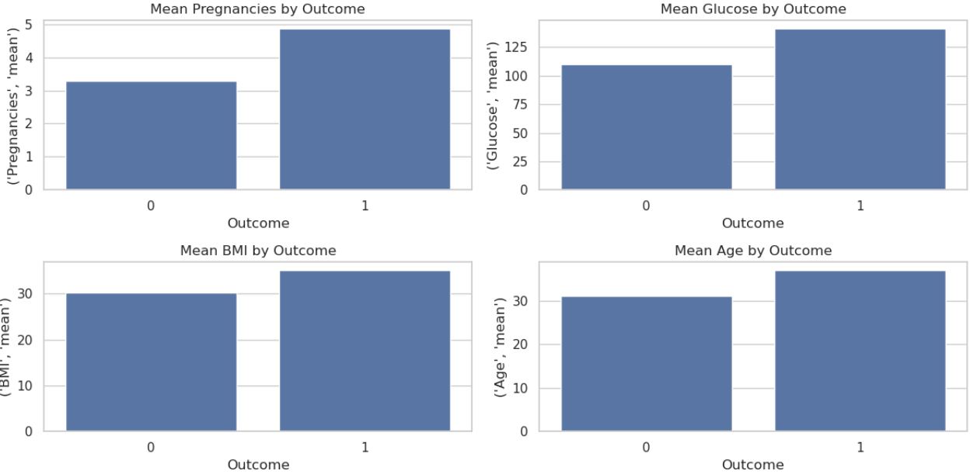
Aggregation result

Slide 6
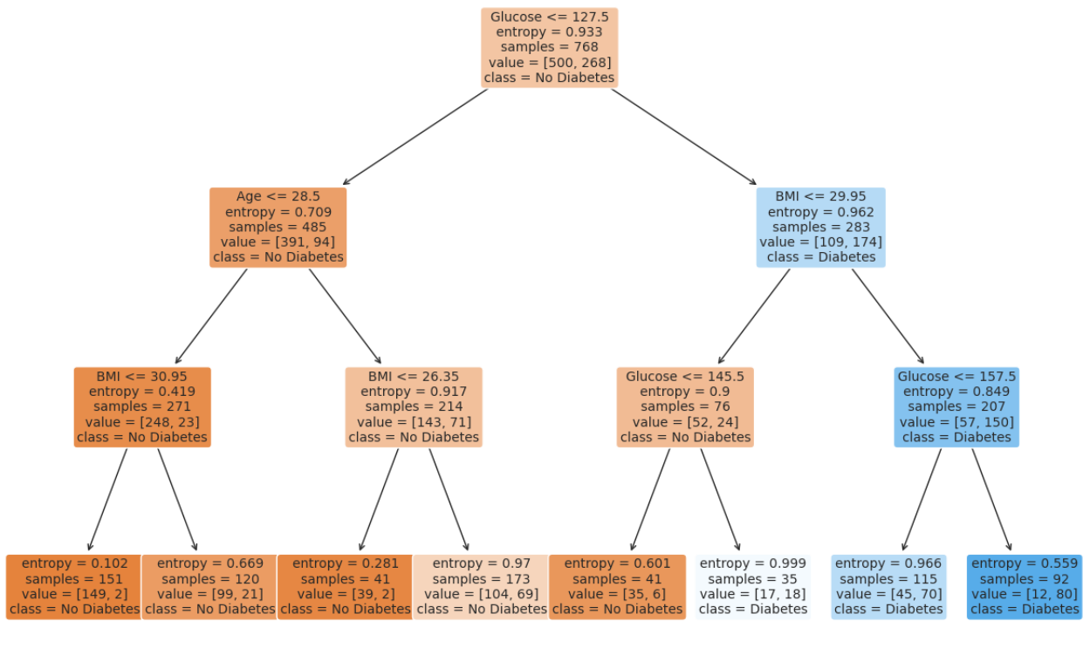
Decision Tree Classification

Slide 7
Logistic regression classification
Confusion matrix:
Actual class\Predicted class C1 ¬ C1
C1 37(TP) 18 (FN)
¬ C1 20 (FP) 79(TN)
Classification Report:
precision recall f1-score support
0 0.81 0.80 0.81 99
1 0.65 0.67 0.66 55
accuracy 0.75 154
macro avg 0.73 0.74 0.73 154
weighted avg 0.76 0.75 0.75 154

Slide 8
IMDB Movies Dataset
Clustering

Slide 9
Preprocessing
Checking for: duplicate data
missing data
Our Dataset consists of:
999 instances
15 attributes: 'Poster_Link', 'Series_Title' ,'Released_Year', 'Certificate' ,'Runtime' ,'Genre' ,'IMDB_Rating' ,'Overview' ,'Meta_score','Director’ ,'Star1', 'Star2','Star3','Star4','No_of_Votes', 'Gross'
We dropped ‘Poster_Link’ and we converted ‘Gross’ to float number.

Slide 10
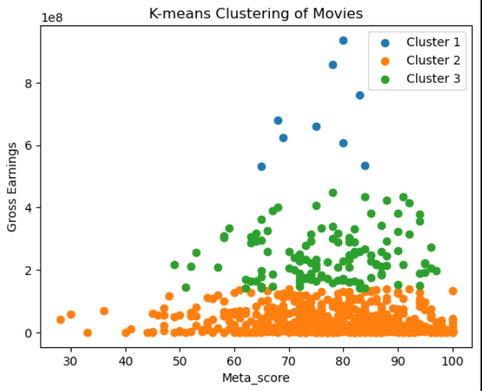
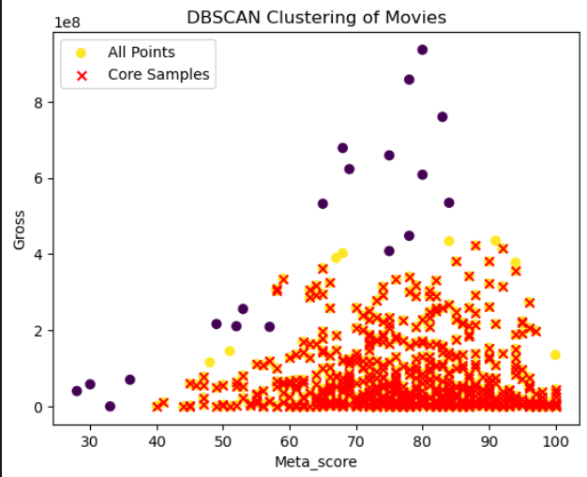
Output from K-Means & DBScan
k=3

Slide 11
Observations & future improvements
Use more of the data
Implement pattern mining
Handle outliers
Use of normalization

Slide 12
Thank you!

